Slide 1


Slide 2
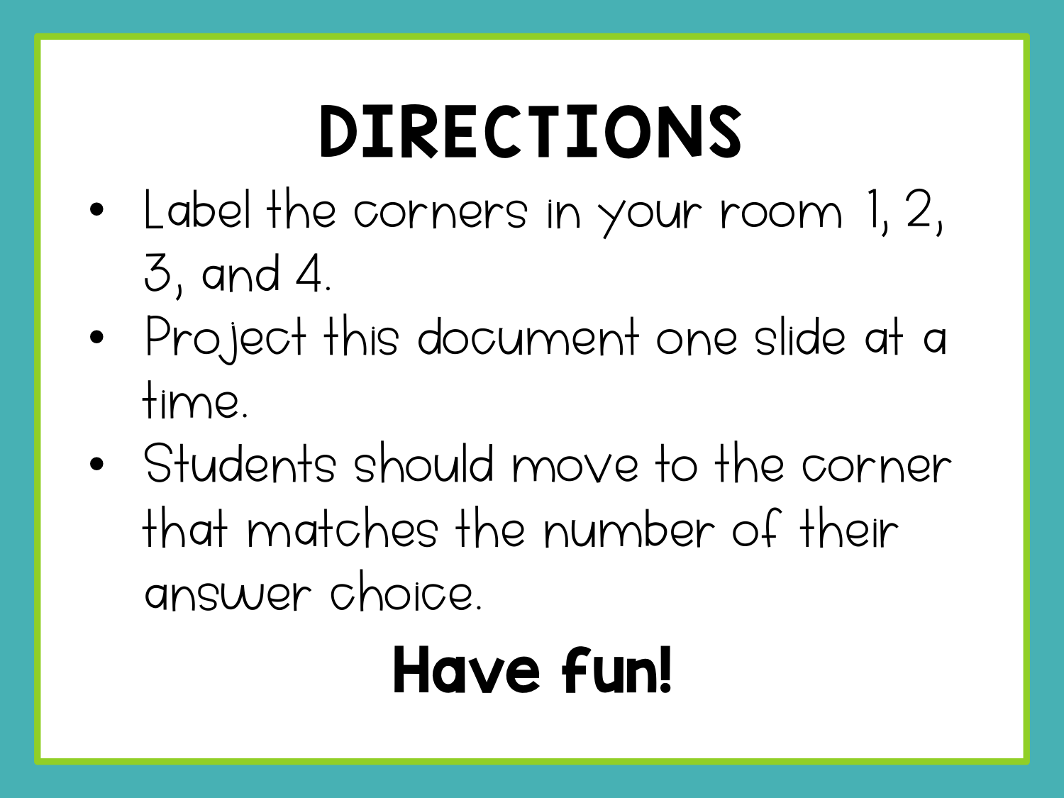

Slide 3
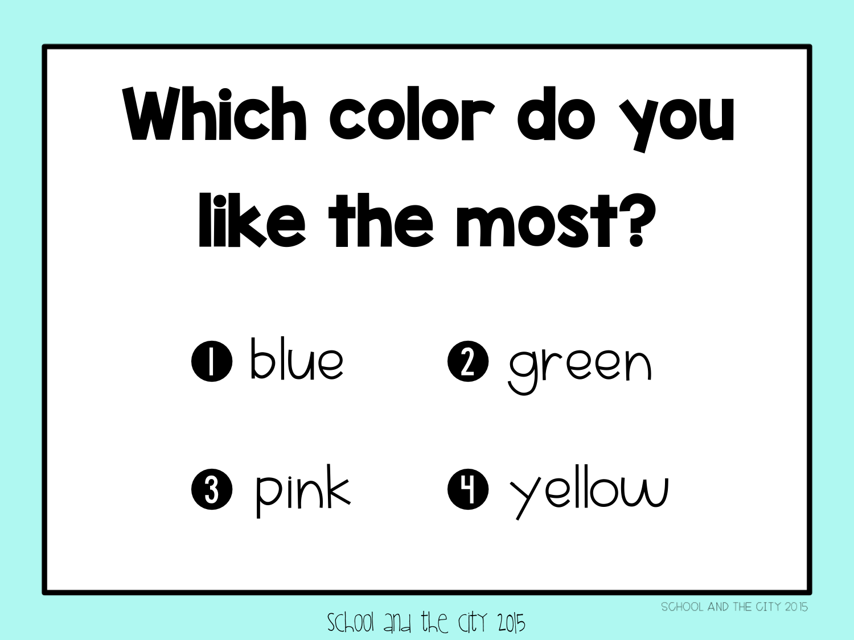

Slide 4
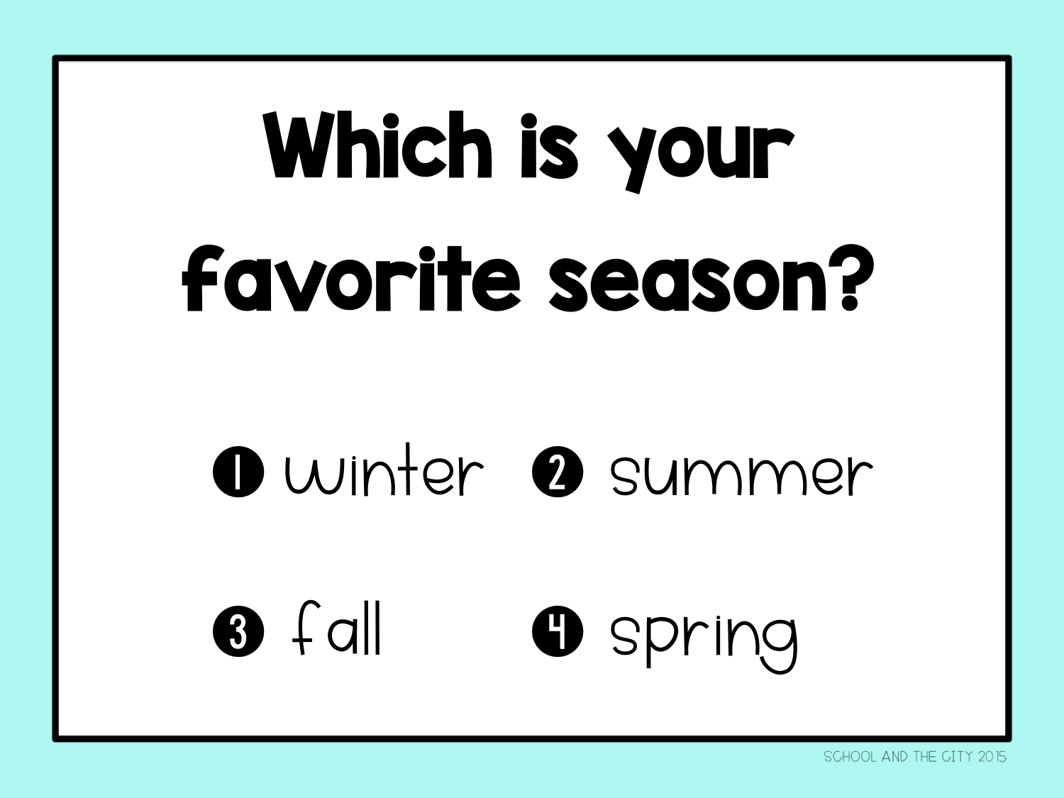

Slide 5
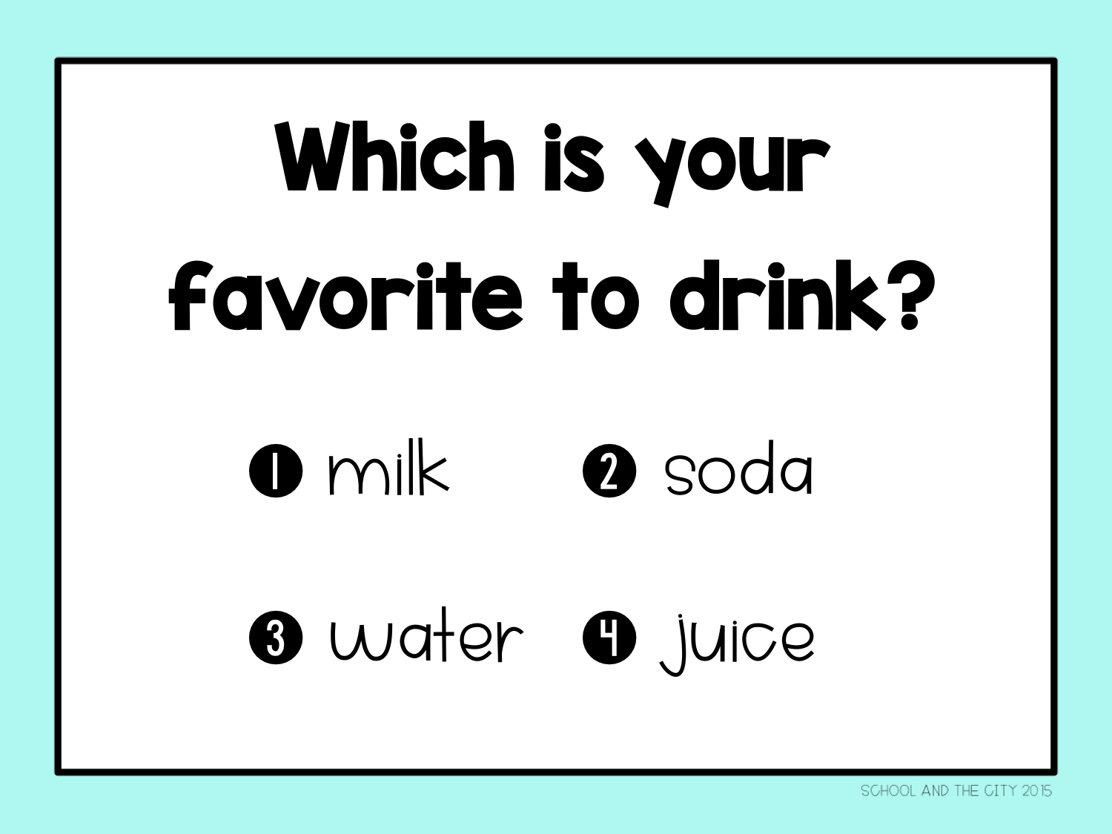

Slide 6
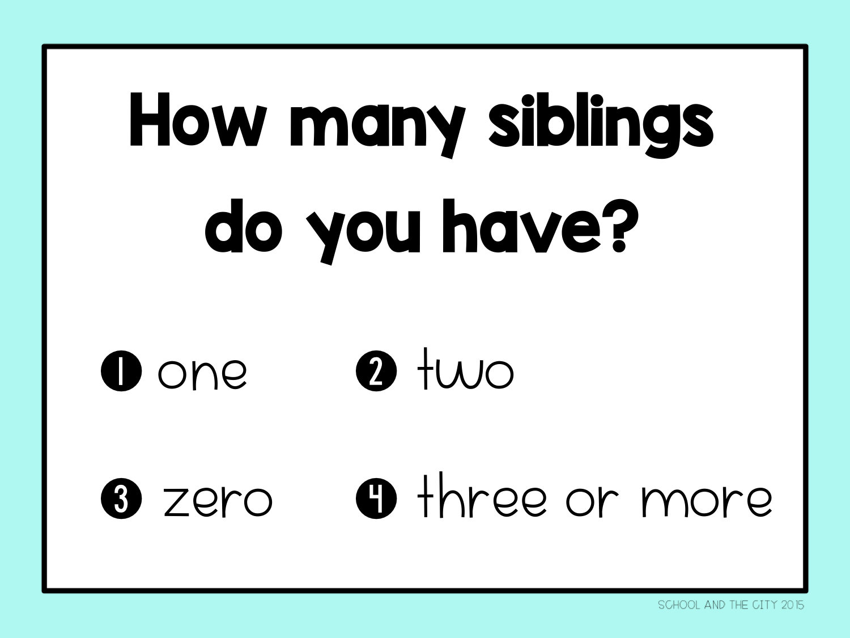

Slide 7
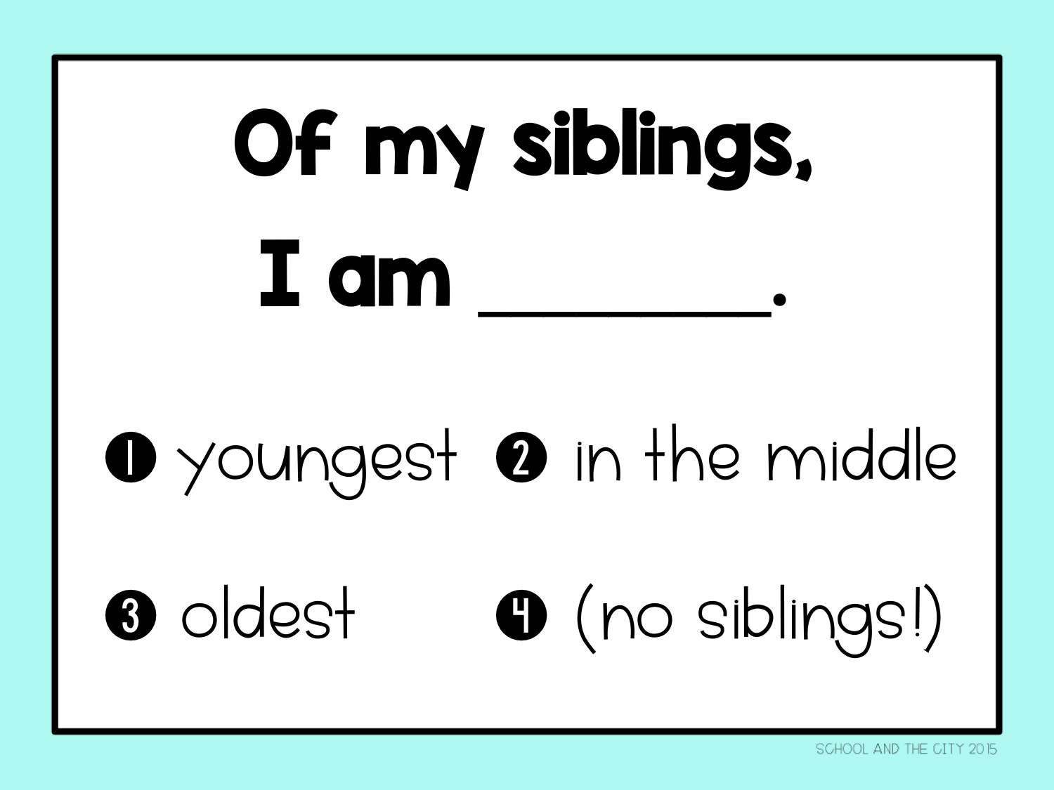

Slide 8
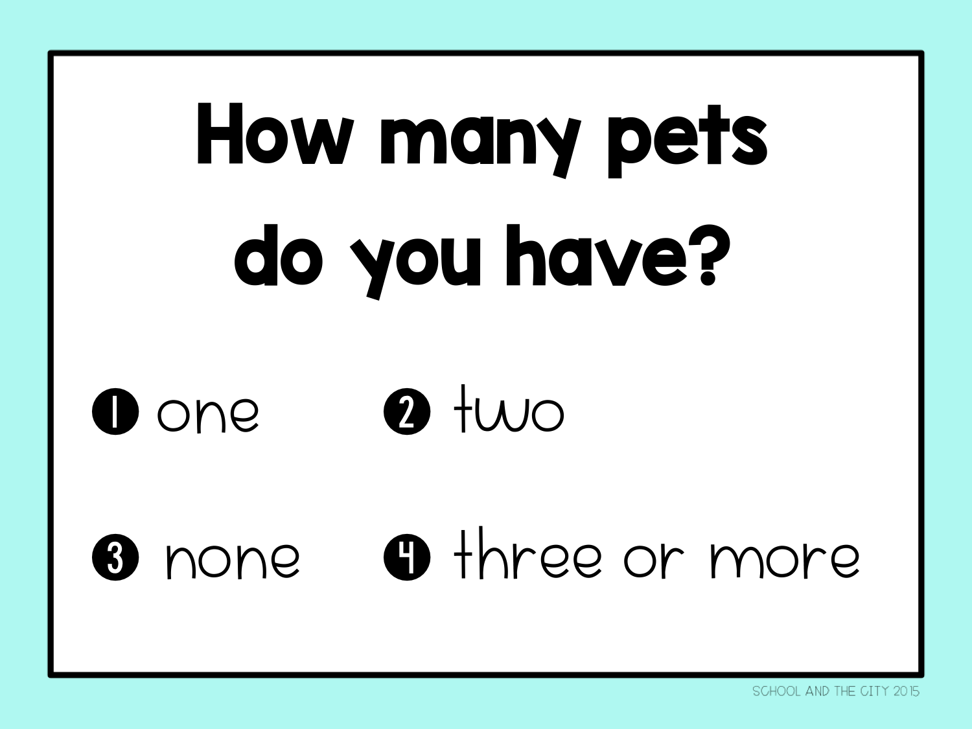

Slide 9


Slide 10


Slide 11


Slide 12


Slide 13
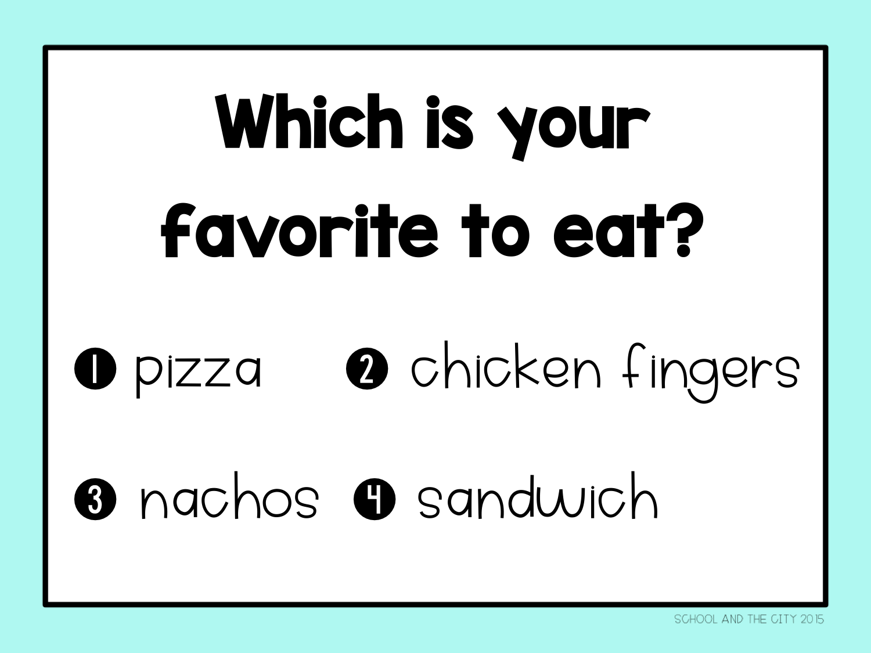

Slide 14
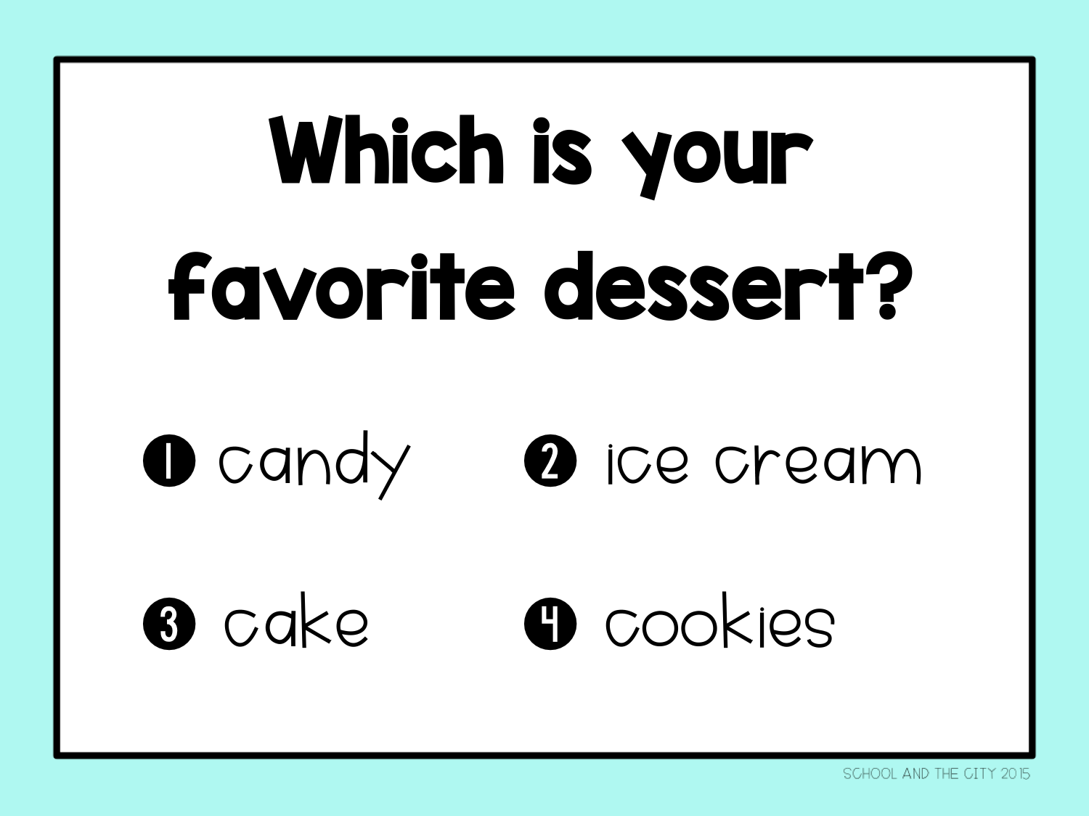

Slide 15
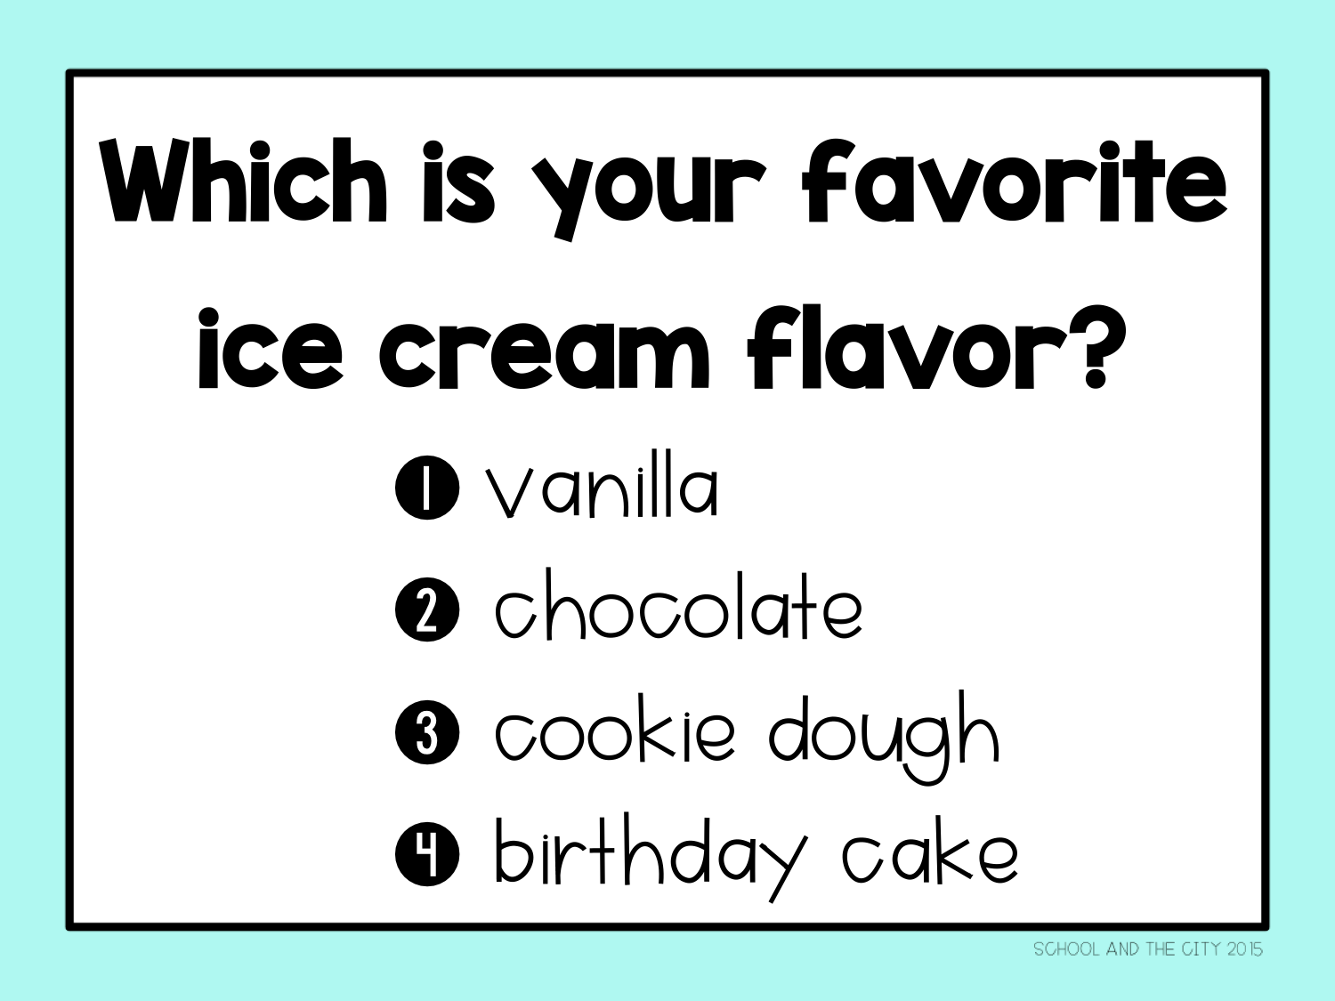

Slide 16
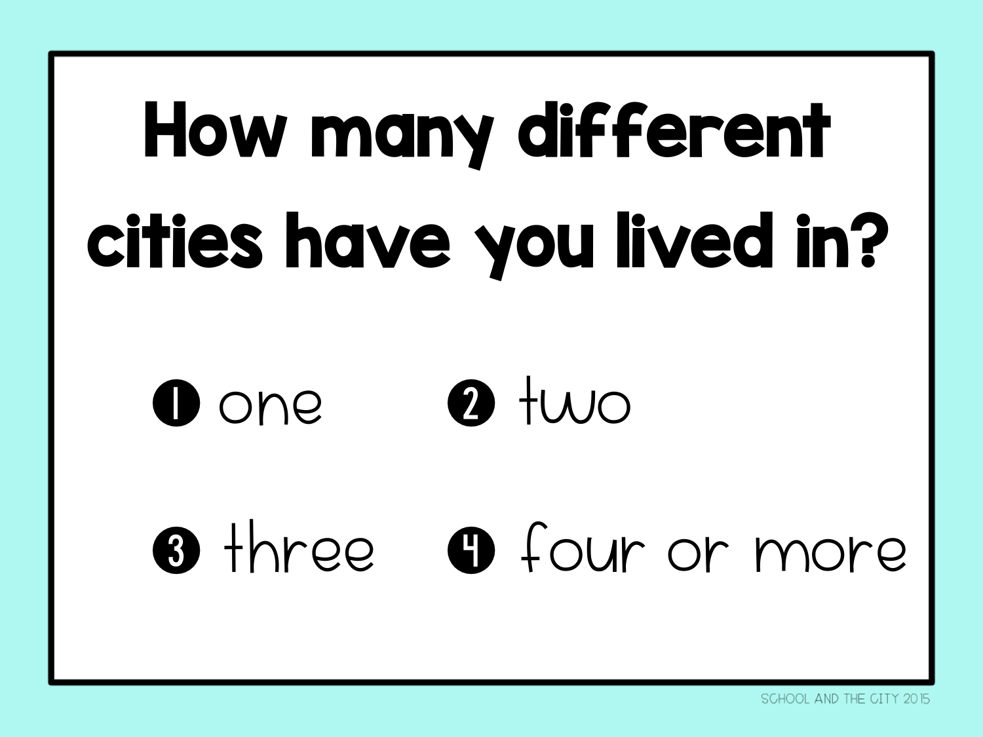

Slide 17


Slide 18


Slide 19


Slide 20


Slide 21


Slide 22
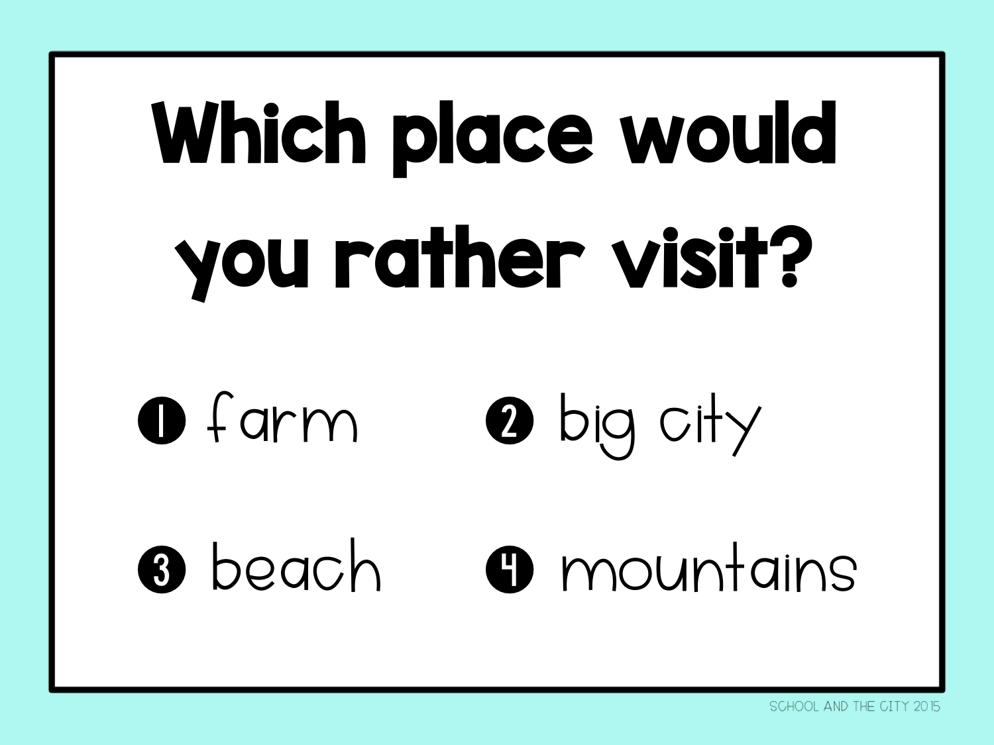

Slide 23
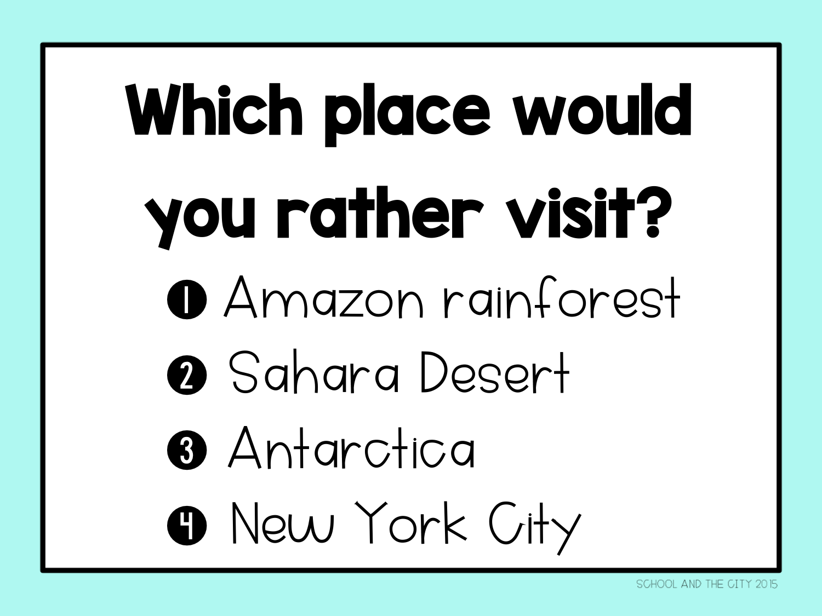

Slide 24


Slide 25


Slide 26


Slide 27


Slide 28


Slide 29

Notes:
TPT: School and the City
Blog: satcblog.com
Email: schoolandthecityblog@gmail.com

Slide 30

Click here to visit the blog post
& download lesson plans.
(Use SlideShow mode to make the hyperlink clickable.)
Notes:
https://satcblog.com/the-first-week-of-3rd-grade-day-by-day/

